Slide 1
Algorithm & Programming
Subject : COMP6047
ALGORITHM AND PROGRAMMING
Year : 2019

Slide 2
Learning Outcomes
At the end of this session, student will be able to:
Define algorithm theory and design (LO1)

Slide 3
Sub Topics
Algorithm and Programming:
Algorithm Definition
Algorithm Development Steps
Pseudo-code
Flow Chart
Structured Theorem
Exercise

Slide 4
Algorithm Definition
Algorithm is a procedure for solving a problem in terms of the actions to be executed, and the order in which these actions are to be executed
Derived from the word algoris and ritmis. Introduced by Al-Khowarizmi.
In the programming domain, algorithm define as method that consist of structured steps in problem solving using computer.

Slide 5
Simple Algorithm Example
Rise and Shine Algorithm
Get out of bed
Take off pajamas
Take a shower
Get dressed
Eat breakfast
Carpool to work

Slide 6
Algorithm Development Steps
PROBLEM
PROCESS
SOLUTION
Algorithm
Source Code
Executable Code
Problem Definition
Model Development
Algorithm Design
Writing Code
COMPILE
Syntax Err
Executable code: => Run
Output Err
Documentation

Slide 7
Algorithm Development Steps
Problem Definition
Model Development
Algorithm Design
Writing Code
COMPILE
Problem:
Finding the solution or root of quadratic equation
Definition:
Quadratic equation : ax^2 + bx + c = 0
Data needed:
Coefficient of a, b and c : real type
Syntax Err
Executable code: => Run
Output Err
Documentation

Slide 8
Algorithm Development Steps
Problem Definition
Model Development
Algorithm Design
Writing Code
COMPILE
Syntax Err
Mathematical model:
Quadratic formula:
x1 = (-b + sqrt(b^2 - 4ac))/2a
x2 = (-b – sqrt(b^2 - 4ac))/2a
Executable code: => Run
Output Err
Documentation

Slide 9
Algorithm Development Steps
Problem Definition
Model Development
Algorithm Design
Writing Code
Start
COMPILE
Input a,b,c
Syntax Err
d = b^2 – 4ac
Executable code: => Run
d < 0
Y
T
Output Err
x1=(-b+sqrt(d))/2a
x2 =(-b-sqrt(d))/2a
Print:
“Imaginary”
Documentation
Print : x1, x2
Stop

Slide 10
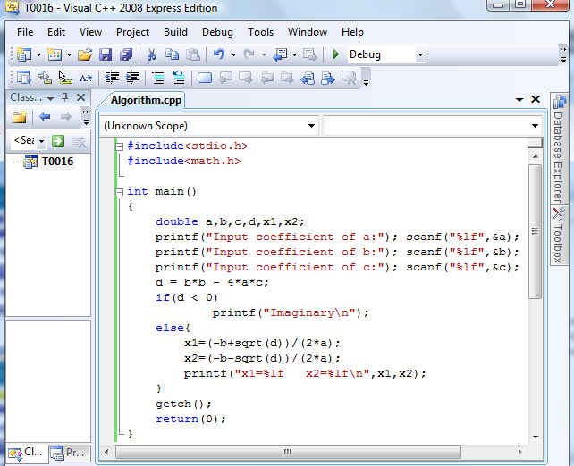
Algorithm Development Steps
Problem Definition
Model Development
Algorithm Design
Writing Code
COMPILE
Syntax Err
Executable code: => Run
Output Err
Documentation

Slide 11
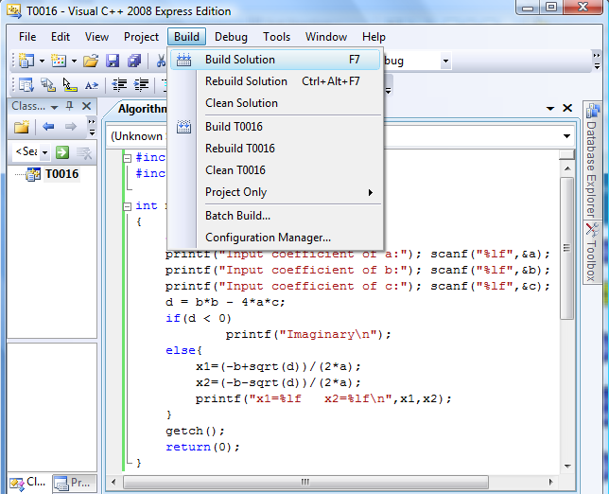
Algorithm Development Steps
Problem Definition
Model Development
Algorithm Design
Writing Code
COMPILE
Syntax Err
Executable code: => Run
Output Err
Documentation

Slide 12
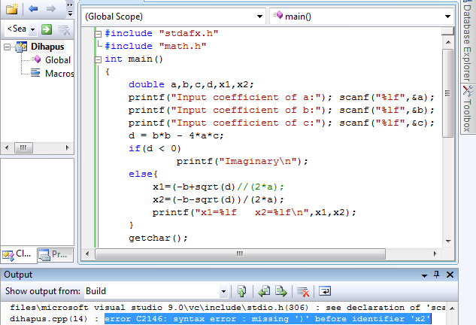
Algorithm Development Steps
Problem Definition
Model Development
Algorithm Design
Writing Code
COMPILE
Syntax Err
Executable code: => Run
Output Err
Documentation

Slide 13
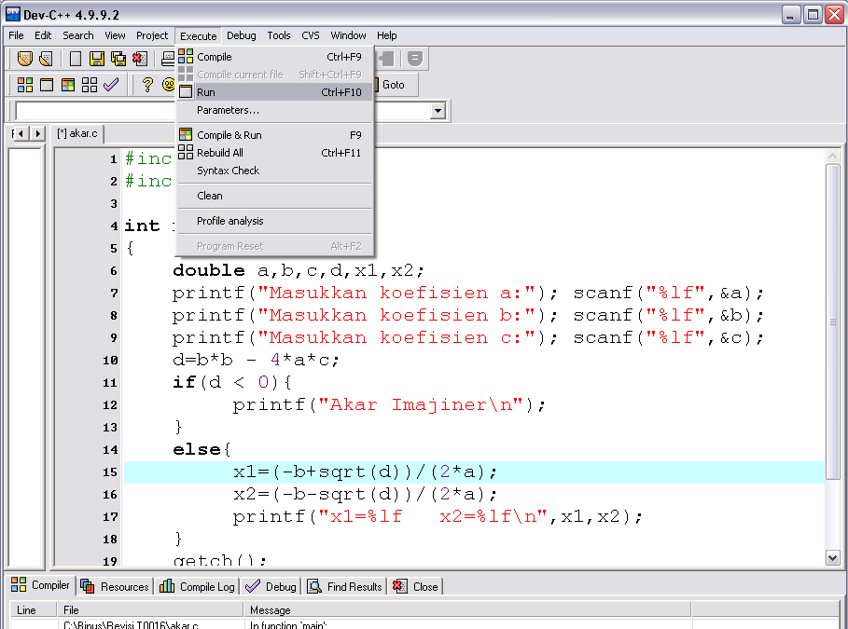
Algorithm Development Steps
Problem Definition
Model Development
Algorithm Design
Writing Code
COMPILE
Syntax Err
Executable code: => Run
Output Err
Documentation

Slide 14
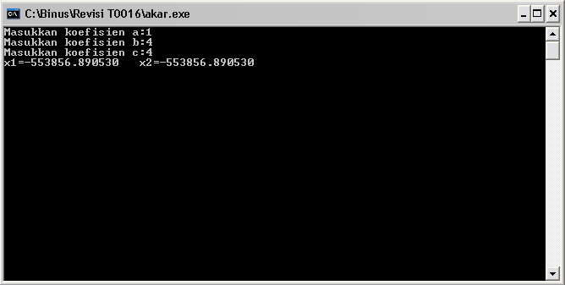
Algorithm Development Steps
Problem Definition
Model Development
Algorithm Design
Writing Code
COMPILE
Syntax Err
Executable code: => Run
Output Err
Documentation

Slide 15
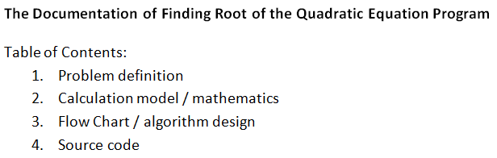
Algorithm Development Steps
Problem Definition
Model Development
Algorithm Design
Writing Code
COMPILE
Syntax Err
Executable code: => Run
Output Err
Documentation

Slide 16
Representing Algorithm
How to develop an algorithm?
We can use:
Writing
Structure English and Pseudo-code.
Drawing
Flow Chart

Slide 17
Pseudo-code
An artificial and informal language that helps you develop algorithms
Pseudo-code is similar to everyday English, convenient, and user friendly
Keywords are used to describe control structure
Example:
if, else, print, set, add, while, etc.

Slide 18
Pseudo-code
Basic Computer Operation:
Input
Output
Compute
Storing value to an identifier (Store)
Compare (Selection)
Repetition (Loop)

Slide 19
1. Input
Statements can be used when a computer receive information or input
Read, Get, Input or Key-In
Example:
Read bilangan
Get tax_code
Baca students_name

Slide 20
2. Output
Statements can be used when a computer displaying information or output:
Print, Write, Put, Output, or Display
Example:
Print “Bina Nusantara University”
Write “Algorithm and Programming”
Output Total

Slide 21
3. Compute
To do arithmetic calculation the following operators are used:
+ (add)
- (subtract)
* (multiply)
/ (divide)
() (scope)
Statement Compute, Calculate or Add also can be used
Example:
Add number to total
Total = Total + number

Slide 22
4. Storing Value to An Identifier (Store)
There are three ways of storing value into a variable:
Initializing value using statement Initialize or Set
Storing value as calculation result using =
To simply store a value into a variable using “Save” or Store
Example:
Set Counter to 0
Total = Price * Qty

Slide 23
5. Compare
One of the main operation in computing is comparing values and choosing options based on its result
Keyword used: IF, THEN and ELSE
Example:
IF Menu=‘1’ THEN
Discount = 0.1 * price
ELSE
Discount = 0.2 * price
ENDIF

Slide 24
6. Repetition (Looping)
To repeat an action/step, we use keyword DOWHILE and ENDDO
Example:
DOWHILE number < 10
print number
number = number +1
ENDDO

Slide 25
Pseudo-code Example
Example : Algorithm using a calculator to sum values
Start
Set the calculator ON
Empty any values
Do
Input price
Push plus button (+)
while all prices have been input
print total price
turn OFF calculator
End

Slide 26
Pseudo-code Example
Example : Algorithm to count average grade of a class
Start
Set total to zero
Set grade counter to one
While grade counter is less than or equal to ten
Input the next grade
Add the grade into the total
Add one to the grade counter
Set the class average to the total divided by ten
Print the class average.
End

Slide 27
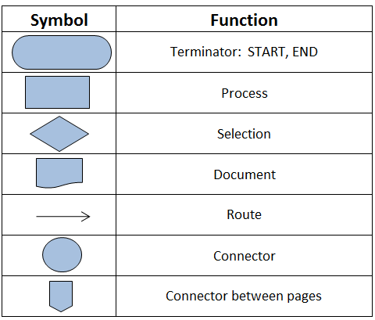
Flow Chart

Slide 28
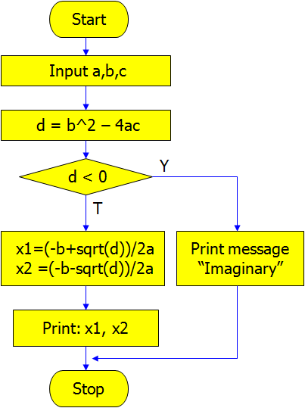
Flow Chart Example

Slide 29
Good Algorithm Practice
Having the right logical flow to solve the problem
Producing the correct output in a time efficient manner
Written using unambiguous structured language
Easy implementation into real programming language
All steps and operations are clearly defined and ended

Slide 30
Structure Theorem
Structure theorem which makes the computer programming possible using only three control structure, which are:
Sequence
Selection
Repetition

Slide 31
1. Sequence
Sequence is series of consecutive commands/statements
Commonly programming language has sequence of statements flowing from top of the program to its end

Slide 32
1. Sequence
Example :
Print “Number of students:”
Set total to 49
Print “Add new student:”
Read newStudent
total = total + newStudent
Print “Number of students:”
Print total
Description
Sequence of command is from the 1st line to the end of code. If newStudent input is 2 then total that later on printed out is 51

Slide 33
2. Selection
Selection control structure is structure that allow us to choose from several options of statement/command
The first statement will be executed if the condition is satisfied, if not then the else statement will be executed (if the other exist)

Slide 34
2. Selection
Example :
IF Day=1 THEN
Print “Monday”
ELSE
Print “Obviously not Monday”
Description
The word “Monday” will be printed out if Day’s value equal to 1, else it will print out the sentence “Obviously not Monday”.

Slide 35
3. Repetition
A number of statements/commands can be repeated several times using Repetition structure control
Statements/commands will be repeated while the looping condition is satisfied
(may use DOWHILE – ENDDO)

Slide 36
3. Repetition
Example :
Stars = 0
DOWHILE Stars < 5
Print Stars
Stars = Stars + 1
ENDDO
Description
At first Stars’ value equals to 0, after following the DOWHILE looping Stars’ value will be updated 5 times resulting:
0 1 2 3 4

Slide 37
Exercise
Using the Pseudo-code, create:
an algorithm to calculate a rectangle area!
an algorithm to change second into hour and minute unit!
an algorithm to decide whether an input number is an odd or even number!
an algorithm to calculate a circle area!
an algorithm to accept three numbers and find the max number!
Repeat no. 1 using Flow Chart

Slide 38
Summary
Algorithm is a procedure for solving a problem in terms of the actions to be executed
Algorithm development steps consists of: problem definition, model development, algorithm design, writing code, and documentation
We can use writing (Structure English and Pseudo-code) or drawing (Flow Chart) to represent algorithm
Basic Computer Operation: input, output, compute, store, compare, and repetition (loop)
Structure theorem are sequence, selection, and repetition

Slide 39
References
Paul Deitel & Harvey Deitel. (2016). C how to program : with an introduction to C++. 08. Pearson Education. Hoboken. ISBN: 9780133976892. Chapter 3
Programming in C: http:// www.cs.cf.ac.uk/Dave/C/
C Language Tutorial: http://www.physics.drexel.edu/courses/Comp_Phys/General/C_basics/
Pseudocode Examples: http://www.unf.edu/~broggio/cop2221/2221pseu.htm
Computer & Internet Help : Understanding Flowchart Symbols: http://www.youtube.com/watch?v=xLoL7tlJYws

Slide 40
END

